Slide 1
Anxiety Disorder
A feeling of worry, nervousness, or unease about something with an uncertain outcome.

Slide 2
What is normal anxiety?
Responding to threatening situation
Defense or escape (fight or flight)
INCREASED
Heart Rate
Blood pressure
Respiration
Sympathetic nervous system
Sweating
Polyuria
Diarrhea
Beneficial response

Slide 3
What is abnormal anxiety?
Respond similar to normal anxiety
But out of proportion to the treat,
And/or is more prolonged

Slide 4
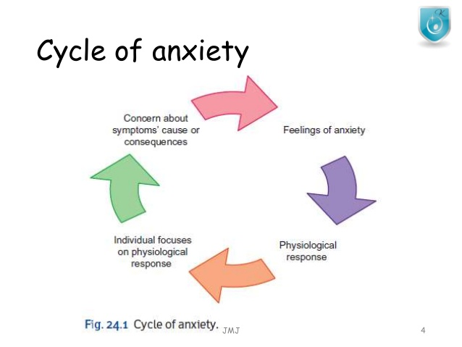

Slide 6
criteria
Developing inappropriate and excessive fear or anxiety concerning separation from those to whom the individual is attached, as evidenced by at least three of the following:
Recurrent excessive distress when anticipating or experiencing separation from home or from major attachment figures.
Persistent and excessive worry about losing major attachment figures or about possible harm to them, such as illness, injury, disasters or death.
Persistent and excessive worry about experiencing an untoward event (eg. Getting lost, being kidnapped, having an accident, becoming ill) that causes separation from a major attachment figure.
Persistent reluctance or refusal to go out, be away from home, go to school, go to work, or elsewhere because of fear of separation.
Persistent and excessive fear or reluctance about being alone or without major attachment figures at home or In other settings.

Slide 7
Criteria con…
Persistent reluctance or refusal to sleep away from home or to go to sleep without being near a major attachment figure.
Repeated nightmares involving the theme of separation.
Repeated complaints of physical symptoms (eg. headaches, stomach aches, nausea, vomiting) when separation from major attachment figures occurs or is anticipated.
The fear, anxiety, or avoidance is persistent, lasting at least 4 weeks in children and adolescents and typically 6 months or more in adults.
The disturbance causes clinically significant distress or impairment in social, academic, occupational, or other important areas of functioning.
The disturbance is not better explained by another mental disorder, such as refusing to leave home because of excessive resistance to change in autism spectrum disorder; delusions or hallucinations concerning separation in psychotic disorders; refusal to go outside without a trusted companion in agoraphobia; worries about ill health or other harm befalling significant others in generalized anxiety disorder; or concerns about having an illness in illness anxiety disorder.

Slide 8
Treatment
For children
Changing in parenting technique
Short separation
For adults
Psychotherapy
Talk therapy
Medication

Slide 9
Anxiety Disorder due to Another medical condition
The essential feature of anxiety disorder due to another medical condition is clinically significant anxiety that is judged to be explained as a psychological effect of another medical condition.

Slide 10
Prevalence
The prevalence of other anxiety disorder due to another medical condition is unclear. This appears to be an elevated prevalence of anxiety disorders among individuals with a variety of medical conditions including asthama,hypertension,ulcers,and arthritis.

Slide 11
Selective mutism
Selective mutism is an anxiety in which a person who is normally capable of speech cannot speak in specific situation or to specific people it is usually co-exists with disorder shyness or social anxiety.

Slide 12
Criteria.
Consistent failure to speak in specific social situations (in which there is an expectation for speaking, e.g., at school) despite speaking in other situations.
The disturbance interferes with educational or occupational achievement or with social communication.
The duration of the disturbance is at least 1 month (not limited to the first month of school).
The failure to speak is not due to a lack of knowledge of, or comfort with the spoken language required in a social situation.
The disturbance is not better accounted for by a Communication Disorder (e.g., Stuttering) and does not occur exclusively during the course of a Persuasive Developmental Disorder, Schizophrenia, or other Psychotic Disorder.

Slide 13
Treatment
Social communication anxiety treatment
Psychodynamic therapy
Family therapy
Behavioral therapy

Slide 14
Specific phobia
Specific phobia formally called a simple phobia is a lasting and unreasonable fear caused by the presence or thought of a specific object or situation that usually poses little or no actual danger

Slide 15
Criteria
Marked fear or anxiety about a specific object or situation (e.g., flying, heights, animals, receiving an injection, seeing blood). Note: In children, the fear or anxiety may be expressed by crying, tantrums, freezing, or cleaning.
B. The phobic object or situation almost always provokes immediate fear or anxiety.
C. The phobic object or situation is actively avoided or endured with intense fear or anxiety.
D. The fear or anxiety is out of proportion to the actual danger posed by the specific object or situation and to the sociocultural context.
E. The fear, anxiety, or avoidance is persistent, typically lasting for six months or more.
F. The fear, anxiety, or avoidance cause clinically significant distress or impairment in social, occupational, or other important areas of functioning.
G. The disturbance is not better explained by the symptoms of another mental disorder including fear, anxiety, and avoidance of situations associated with panic-like symptoms or other incapacitating symptoms (as in agoraphobia); objects or situations related to obsessions (as in obsessive-compulsive disorder); reminders of traumatic events (as in posttraumatic stress disorder); separation from home or attachment figures (as in separation anxiety disorder); or social situations (as in social anxiety disorder).

Slide 16
Causes
Traumatic event
Observing others suffering from
Information transmission

Slide 17
Symptoms
Physical Symptoms:
Racing heart
Difficulty breathing
Trembling or shaking
Sweating
Nausea
Dry mouth
Chest pain or tightness
Emotional Symptoms:
Feeling overwhelming anxiety or fear
Knowing that your fear is irrational, but feeling powerless to overcome it
Fear of losing control
Feeling an intense need to escape

Slide 18
Treatment
Cognitive behavioral therapy
Medication

Slide 19
SOCIAL ANXIETY DISORDER 300.23(F40.10)

Slide 20
DSM-5 CRITERIA
Marked fear or anxiety about one or more social situations.
Exposure to the trigger leads to intense anxiety about being evaluated negatively.
Triggered situations are avoided.
Symptoms persist for at least 6 months.
The social situations almost always provoke fear or anxiety.
The anxiety cause clinically significant distress or impairment in social, occupational and other areas of functioning.

Slide 21
SYMPTOMS
Behave in embarrassing ways.
Fear to speak in public.
Blush or sweat.
Tremble
Fast heartbeat
Feeling that your mind has gone blank
Avoid making eye contact
Avoid interacting with others

Slide 22
RISK FACTORS
Likely to develop social anxiety disorder if your parent or sibling have same condition.
Children who experience teasing , bullying , rejection, may be more prone to social anxiety disorder.
Children who are shy, and timid facing new situations may be at greater risk.

Slide 23
COMORBIDITY
Social anxiety disorder is often comorbid with other anxiety disorders , major depressive disorder, and substance use disorder.

Slide 24
PANIC DISOREDER 300.01(F41.0)

Slide 25
DSM 5 CRITERIA
Recurrent uncured panic attacks.
At least one of the attack has been followed by 1 month.

Slide 26
SYMPTOMS
Labored breathing.
Heart palpitations.
Nausea.
Upset stomach.
Sweating
Chills
Depersonalization(feeling of being outside one’s body)
Derealization(feeling of world not being real)
Flee from situation

Slide 27
RISK FACTORS
Negative effectivity and anxiety sensitivity are risk factors for the onset of panic disorders.
Reports of childhood experience of sexual and physical abuse are more common in panic disorders.
There is an increased risk for panic disorder among offspring of parents with anxiety, depressive and bipolar disorders.

Slide 28
COMORBIDITY
The panic disorder comorbid with other anxiety disorders specially agoraphobia, major depression, bipolar disorder, and possibly mild alcohol use disorder.
Panic disorder comorbid with significant medical symptoms and conditions including dizziness, cardiac arrest, and asthma.

Slide 29
This category applies to presentations in which symptoms characteristics of an anxiety disorder cause significant distress or impairment in social, occupational, or other areas of functioning but do not meet full criteria for any of the disorders in the anxiety disorder

Slide 30
OTHER SPECIFIED ANXIETY DISORDER
300.09(F41.8)

Slide 31
This category applies to presentations in which symptoms characteristics of an anxiety disorder cause significant distress or impairment in social, occupational, or other areas of functioning but do not meet full criteria for any of the disorders in the anxiety disorder

Slide 32
ANXIETY DISORDERS
AGORAPHIBIA

Slide 33
DIAGNOSTIC CRITERIA
The diagnosis requires endorsement of symptoms occurring in at least two of the following five situations
1) using public transportation such as automobiles , buses , trains , ships , plans.
2) being in open spaces , such as parking a lots , market places , or bridges
3) being in enclosed spaces , such as shops theaters , or cinemas
4) Standing in line or being in crowd
5) being outside of the home alone.

Slide 34
PREVALENCE
Every years approximately 1.7% of adolescents and adults have a diagnosis of agoraphobia . Agoraphobia may occur in childhood ,but incidence peaks in late adolescence and early adulthood. Females are twice as likely as males to experience agoraphobia.

Slide 35
RISK FACTORS
Environmental : Negative events in childhood and other stressful events ( such as separation or death of parent )

Slide 36
COMORBIDITY
The majority of individuals with agoraphobia also have other mental disorders(e . g specific phobias , panic disorders , social anxiety disorders . Whereas other anxiety disorders (major depressive disorder) PTSD , and alcohol use disorder.

Slide 37
GENERALIZED ANXIETY DISORDER
DIAGNOSTIC CRITERIA:
Excessive anxiety and worry at least 50 percent of days about at least two life domains
The worry is sustained at least 3 months
The anxiety and worry are associated with at least 3 of the following
Restlessness
Being easily fatigued
Difficulty concentrating or mind going
Irritability
Muscles tension
Sleep disturbance

Slide 38
PREVALENCE
Females are twice as likely males to experience generalized anxiety disorder

Slide 39
RISK FACTORS
ENVIRONMENTAL :Childhood advertise and parent overprotection have been associated with generalized anxiety disorder.

Slide 40
COMORBIDITY
Individuals whose presentation meets criteria for generalized anxiety disorder and likely to have met , currently meet, criteria for other anxiety and depressive disorders.

Slide 41
PANIC ATTACK SPECIFIER
An abrupt surge of intense fear or intense discomfort that reaches a peak within minutes is panic attack.
Panic attack can occur in the context of any anxiety disorder as well as other mental disorders(e.g., posttraumatic stress disorder and depressive disorders etc.).
There are two characteristic types of panic attacks: expected and unexpected. Expected panic attacks are attacks for which there is an obvious cue or trigger, such as situation in which panic attacks have typically occurred. Unexpected panic attacks are those for which there is no obvious cue or trigger at the time of occurrence.
Panic attack can occur in the context of any mental disorder and some medical conditions.

Slide 42
SYMPTOMS OF PANIC ATTACK
Four (or more) of the following symptoms occur:
Palpitations.
Sweating.
Trembling or shaking.
Sensation or shortness of breath.
Feeling of choking.
Chest pain or discomfort.
Nausea or abdominal distress.
Feeling dizzy, unsteady or faint.
Chills or heat sensations.
Paresthesia's.
Derealization.
Feeling of losing controls.
Fear of dying.
Eleven out of these 13 symptoms are physical.

Slide 43
PREVALENCE
In the general population,12 month prevalence estimates for panic attacks in United States is 11.2% in adults. Females are more frequently affected than males.
Panic attack can occur in children but are relatively rare until the age of puberty.

Slide 44
RISK AND PROGNOSTIC FACTORS
TEMPERAMENTAL:Negative affectivity and anxiety sensitivity are risk factors for the onset of panic attacks. History of “fearful spells” may be a risk factor for later panic attacks.
ENVIRONMENTAL: Smoking is a risk factor for panic attacks. Most individual report identifiable stressors in the months before their first panic attack.

Slide 45
COMORBIDITY
Panic attacks are associated with increased likelihood of various comorbid mental disorders, including anxiety disorders, and substance use disorders.

Slide 46
Substance/medication induced anxiety disorder.

Slide 47
DIAGNOSTIC CRITERIA
Panic attacks or anxiety is predominant in the clinical picture.
There is evidence from the history, physical examination, or laboratory findings of both (1) and (2):
The symptoms in Criterion A developed during or soon after substance intoxication or withdrawal or after exposure to a medication.
The involved substance/medication is capable of producing the symptoms in Criterion A.
The disturbance is not better explained by an anxiety disorder that is not substance/medication-induced.
The disturbance does not occur exclusively during the course of a delirium.
The disturbance causes clinically significant distress or impairment in social,occupational,or other important areas of functioning.

Slide 48
DIAGNOSTIC FEATURES
The essential features of substance/medication-induced anxiety disorder are prominent symptoms of panic or anxiety (Criterion A) that are judged to be due to the effects of a substance (e.g., a drug of abuse, a medication).The panic or anxiety symptoms must have developed during or soon after substance intoxication or withdrawal, and the substance or medications must be capable of producing the symptoms of (criterion B2).The substance induced anxiety disorder diagnosis should be made instead of a diagnosis of substance intoxication or substance withdrawal only when the symptoms in Criterion A are predominant in the clinical picture and are sufficiently severe to warrant independent clinical attention.

Slide 49
ASSOCIATED FEATURES SUPPORTING DIAGNOSIS
Panic or anxiety can occur in association with intoxication with the following classes of substance:alcohol,caffeine, cannabis, other hallucinogens,inhalants,stimilants (including cocaine)and other substance.
Panic or anxiety disorder can occur in association with withdrawal from the following classes of substance: alcohol;opioids;sedatives,hypnotics,and stimulants including cocaine.
Some medications that evoke anxiety symptoms include anesthesia and analgesics,insulin,thyroid preparations. Antiparkinsonian medication, cardiovascular medications and antidepressant medications.

Slide 50
PREVALENCE
The prevalence of substance/medication induced anxiety disorder is not clear. General population data suggest that it may be rare, with a 12 month prevalence of approximately 0.002%.

Slide 51
DIAGNOSTIC MARKERS
Laboratory assessments (e.g., urine toxicology)may be useful to measure substance intoxication as part of an assessment for substance/medication-induced anxiety disorder.

Slide 52
DIFFERENTIAL DIAGNOSIS
Anxiety disorder (i.e., not induced by a substance/medication). Substance / medication-induced anxiety disorder is distinguished from a primary anxiety disorder based on the onset, course and other factors with respect to substance/ medication. For drugs of abuse, there must be evidence from the history, physical examination or laboratory findings for use, intoxication, or withdrawal.
Delirium. If panic or anxiety symptoms occue exclusively during the course of delirium, they are considered to be an associated feature of delirium and are not diagnosed separately.
Anxiety disorder due to another medical condition. If the panic or anxiety symptoms are attributed to the physiological consequences of another medical condition, anxiety disorder due to another medical conditions should be diagnosed.

Slide 53
Unspecified Anxiety Disorder
This category applies to presentations in which symptoms characteristics of an anxiety disorder that cause clinically significant distress or impairment in social, occupational or other important areas of functioning predominate but do not meet the full criteria for any of the disorders in the anxiety disorders diagnostic class.

Slide 54
Symptoms
Irritability
Panic attacks
Detachment
Avoidance
Nervousness
Extreme anxiety

Slide 55
Treatment
Therapy and counseling can help a person to deal with these symptoms of these disorders while also teaching them methods to avoid future problems.

Slide 56
Anxiety Disorder due to Another medical condition
The essential feature of anxiety disorder due to another medical condition is clinically significant anxiety that is judged to be explained as a psychological effect of another medical condition.

Slide 57
Prevalence
The prevalence of other anxiety disorder due to another medical condition is unclear. This appears to be an elevated prevalence of anxiety disorders among individuals with a variety of medical conditions including asthama,hypertension,ulcers,and arthritis.

Slide 58
Development and course
This diagnosis is not meant to include primary anxiety disorders that arise in the context of chronic medical illness. This is important to consider with other adults, who may experience chronic medical illness and then develop independent anxiety disorders secondary to the chronic mental illness.

Slide 59
Obsessive Compulsive Disorder

Slide 60
Diagnostic criteria
Obsessions(recurrent, intrusive, persistent, unwanted thoughts, urges, or images that a person tries to ignores suppress, or neutralize)
Compulsions(repetitive behaviours or thoughts that a person feels compelled to perform to prevent distress or a dreaded event or in response to an obsession)

Slide 61
Diagnostic features
Obsessions are not pleasurable or experienced as voluntary :they are intrusive and unwanted and caused marked distress or anxiety in most individuals.
The individuals attempts to ignore or suppress these obsessions (e.g., avoiding triggers or using through suppression) or neutralize them with another thought and action.
Compulsions are repetitive behaviours (e.g., washing, checking ) or mental acts (counting repeating words silently) that the individuals feels driven to perform in response to an obsession .

Slide 62
Risk and prognostic features
Environmental. Physical and sexual abuse in childhood and other stressful or traumatic events have been associated with an increased risk for developing OCD .
Genetic and physiological. The rate of OCD among first-degree relatives of adults with OCD is approximately two times that among first-degree relatives of those without the disorder however among the first-degree relatives of individuals with onset of OCD in childhood or adolescence, the rate is increased 10-fold.

Slide 63
comorbidity
Individuals with OCD often have other psychopathology. Many adults with the disorder have a lifetime diagnosis of an anxiety disorder(76% e.g. Panic disorder, social anxiety disorder, specific phobia)
Up to 30% of individuals with OCD also have a lifetime tic disorder.

Slide 64
Body Dysmorphic Disorder

Slide 65
Diagnostic Criteria
Preoccupation with one or more perceived defects or flaws in physical appearance that are not observable or appear slight to others.
At some point during the course of the disorder, the individual has performed repetitive behaviour (e.g. mirror checking, skin picking, excessive grooming) or mental acts (e.g. comparing his or her appearance with that of others).

Slide 66
Diagnostic Features
Individuals with BDD re preoccupied with one or more perceived defects or flaws in their physical appearance, which they believe look ugly, unattractive, abnormal, or deformed.
Any body area can be the focus of concern (e.g. Eyes, teeth, weight, stomach, legs, face size and shape, lips, chin)

Slide 67
Risk and Prognostic Factors
Environmental. BDD has been associated with high rates of childhood neglect and abuse.
Genetic and physiological. The prevalence of BDD is elevated in first –degree relatives of individuals eith OCD.

Slide 68
Comorbidity
Major depressive disorder is the most common comorbid disorder,with onset usually after that of BDD.

Slide 69
Obsessive-Compulsive and Related Disorder Due to Another Medical Condition

Slide 70
Diagnostic Criteria
Obsessions, compulsions, preoccupations with appearance, hoarding, skin picking, hair pulling, other body focused repetitive behaviours, or other symptoms characteristic of obsessive-compulsive and related disorder.
The disturbance is not better explained by another mental disorder.

Slide 71
Diagnostic Features
Symptoms can include prominent obsessions, compulsions, preoccupation with appearance, hording, hair picking, skin picking or other body focused repetitive behaviours.
The obsessive compulsive and related symptoms must cause clinically significant distress or impairment in social, occupational, or other important areas of functioning.

Slide 72
Associated Features Supporting Diagnosis
A number of other medical disorder are known to include obsessive compulsive and related symptoms. Examples include disorders leading to striatal damage, such as cerebal infection.

Slide 73
Hoarding Disorder
a new disorder in DSM-5, is characterized by a persistent reluctance to discard objects, resulting in severely obstructed living spaces, distress, impairment and, often, adverse repercussion both for the sufferer and for those around this individual The British Journal of Psychiatry

Slide 74
Diagnostic criteria
Persistent difficulty discarding or parting with possessions, regardless of their actual value.
This difficulty is due to a perceived need to save the items and distress associated with discarding them.
The difficulty discarding possessions result in the accumulation of possessions that congest and clutter active living areas and substantially compromises their intended use.
Hoarding causes clinically significant distress or impairment in social, occupational, other important areas of functioning.
The hoarding is not attribute to other medical condition.
Hoarding is not better explained by the symptoms of other disorder.

Slide 75
Diagnostic features
The essential feature of hoarding disorder is persistent difficulties discarding or parting with possessions, regardless of their actual value (Criterion A).
Individuals with hoarding disorder purposefully save possessions and experience distress when facing the prospect of discarding them (Criterion B).
Individuals accumulate large numbers of items that fill up and clutter active living areas to the extent that their intended use is no longer possible (Criterion C).
Symptoms (i.e., difficulties discarding and/or clutter) must cause clinically significant distress or impairment in social, occupational, or other important areas of functioning, including maintaining a safe environment for self and others (Criterion

Slide 76
Prevalence
approximately 2%-6% in Europe and United States.
affects both males and females, but some epidemiological studies have reported a significantly greater prevalence among males.
almost three times more prevalent in older adults (ages 55-94 years) compared with younger adults (ages 34-44 years).

Slide 77
Development and course
Hoarding symptoms may first emerge around ages 11-15 years.
Once symptoms begin, the course of hoarding is often chronic.

Slide 78
comorbidity
75% of individuals with hoarding disorder have a comorbid mood or anxiety disorder.
Most common comorbid conditions are major depressive disorders, social anxiety disorder, and generalized anxiety disorder.
20% percent of individuals with hoarding disorder also have symptoms that meet criteria of OCD.

Slide 79
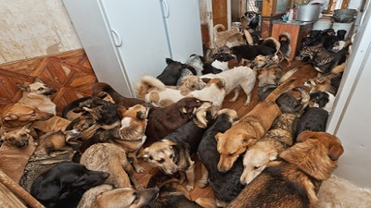
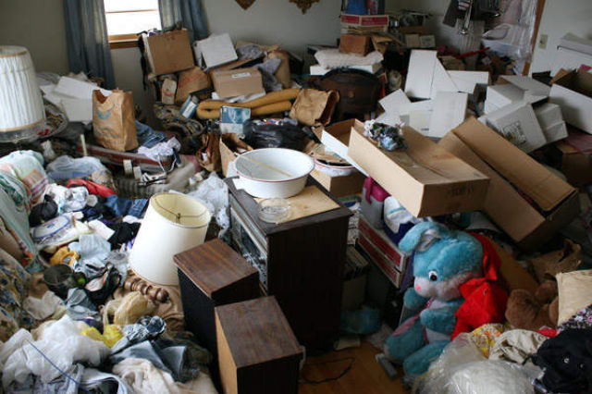

Slide 80
Substance-induced obsessive compulsive and related disorder
Substance/medication induced obsessive-compulsive and related disorder is the lengthy, somewhat complicated name for a newly defined mental health condition that appears in DSM 5, the recently released fifth edition of the Diagnostic and Statistical Manual of Mental Disorders. People with this condition have symptoms that closely resemble the symptoms of obsessive-compulsive disorder (OCD) or any one of several other conditions closely linked to OCD. However, these symptoms stem from the effects of a medication or a legal or illegal substance, not from the internal brain dysfunctions that normally trigger OCD and similar mental health problems.

Slide 81
Diagnostic criteria
A. Obsessions, compulsions, skin picking, hair pulling, other body-focused repetitive behaviors, or other symptoms characteristic of the obsessive-compulsive and related disorders predominate in the clinical picture.
B. There is evidence from the history, physical examination, or laboratory findings of both (1)and (2):
1. The symptoms in Criterion A developed during or soon after substance intoxication or withdrawal or after exposure to a medication.
2. The involved substance/medication is capable of producing the symptoms in Criterion A.
C. The disturbance is not better explained by an obsessive-compulsive and related disorder that is not substance/medication-induced. Such evidence of an independent obsessive-compulsive and related disorder could include the following:

Slide 82
Diagnostic criteria
The disturbance is not better explained by an obsessive-compulsive and related disorder that is not substance/medication-induced. Such evidence of an independent obsessive-compulsive and related disorder
D. The disturbance does not occur exclusively during the course of a delirium.
AND
E. The disturbance causes clinically significant distress or impairment in social, occupational, or other important areas of functioning.

Slide 83
Diagnostic features
Essential feature of substance induced obsessive compulsive and related disorder are symptoms of an obsessive compulsive and related disorder that are judged to be attributable to the effect of a substance.
The obsessive compulsive and related disorder symptoms must have developed during or soon after substance intoxication or withdrawal or after exposure to medication or toxin and substance must be capable of producing symptom.
Substance induced obsessive compulsive and related disorder due to prescribed treatment for a mental disorder or general medical condition must have its onset while the individual is receiving the medication
features

Slide 85
Unspecified obsessive compulsive and related disorder
This category applies to presentations in which symptoms characteristic of an obsessive-compulsive and related disorder that cause clinically significant distress or impairment of social, occupational and other important area of functioning predominant but not meet the fully criteria for any of the disorders in the obsessive-compulsive and related disorders diagnostic class.
The unspecified obsessive-compulsive and related disorder is used in situation in which the clinician chooses not to specify the reason that the criteria are not met for a specific obsessive-compulsive and related disorder.
It includes presentations in which there is sufficient information to make a more specific diagnosis.

Slide 86
trichotillomania
Trichotillomania is an impulse control disorder. People with this disorders know that they can do damage by acting on the impulses, but they cannot stop themselves. They may pull out their hair when they're stressed as a way to try to soothe themselves.

Slide 87
Diagnostic criteria
Recurrent hair pulling resulting in visible hair loss
Repeated attempts to decrease or stop hair pulling
The hair pulling causes clinically significant distress or impairment in social, occupation, or other important areas of functioning
The hair pulling is not attributable to the psychological effects of a substance (e.g., cocaine) or another medical condition (e.g., scabies)
The hair pulling is not better explained by symptoms of another mental disorder

Slide 88
Diagnostic Features
Hair pulling may accur from any regions of body in which hair grows the most common sites are scalp, eyebrows, eyelids and less common sites are pubic, axillary, facial and peril-rectal regions
Hair pulling sites may very over time may be occur in episodes sometimes or it can be sometimes continued for specific hours
Hair pulling may endure for months or years
Individual with this disorder may pull hair in a widely distributed patterns such that hair loss may not be clearly visible
Hair pulling causes clinically significant distress or impairment in social, occupational, or other important areas of functioning

Slide 89
Prevalence
12 months in adults and adolescents
Females are more frequently affected than males.

Slide 90
Development and course
trichotillomania most commonly coincides with, or follows the onset of puberty.
Symptoms may possibly worsen in females accompanying hormonal changes (e.g., menstruation, per menopause).
For some individuals, the disorder may come and go for weeks, months, or years at a time

Slide 91
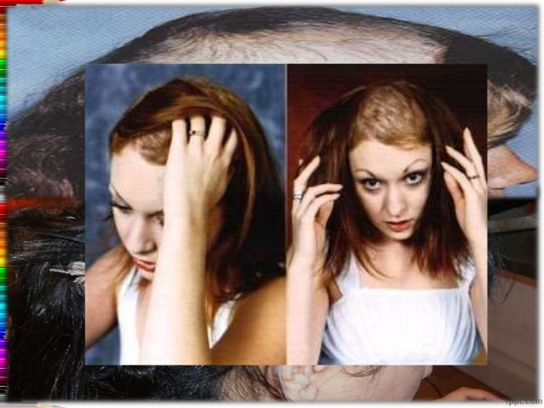

Slide 92
Excoriation
Excoriation disorder (also referred to as chronic skin-picking or dermatillomania) is a mental illness related to obsessive-compulsive disorder. It is characterized by repeated picking at one’s own skin which results in skin lesions and causes significant disruption in one’s life.

Slide 93
Diagnostic criteria
Recurrent Skin picking resulting in skin lesions
Repeated attempts to decrease or stop skin picking.
The skin picking causes clinically significant distress or impairment in social, occupational, or other important areas of functioning.
The skin picking is not attributable to the physiological effects of a substance (e.g., cocaine) or another medical condition (e.g., scabies).
The skin picking is not better explained by symptoms of another mental disorder (e.g., delusions or tactile hallucinations in a psychotic disorder, attempts to improve a perceived defect or flaw in appearance in body dysmorphic disorder, stereotypic movement disorder, or non-suicidal seif harm).

Slide 94
Diagnostic features
The essential feature of excoriation (skin-picking) disorder is recurrent picking at one's own skin (Criterion A).
The most commonly picked sites are the face, arms, and hands, but many individuals pick from multiple body sites.
In addition to skin picking, there may be skin rubbing, squeezing, lancing, and biting.
Individuals with excoriation disorder have made repeated attempts to decrease or stop skin picking

Slide 95
prevelance
life time prevlance in 1.4%adults.
Three-quarters or more of individuals with the disorder are female.

Slide 96
Development and course
onset during adolescence, following the onset of puberty.
The disorder frequently begins with a dermatological condition, such as acne.
For some individuals, the disorder may come and go for weeks, months, or years at a time.

Slide 97
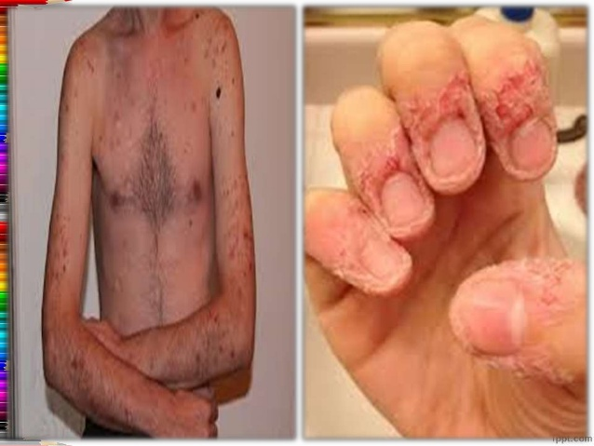

Slide 98
Other specified Obsessive Compulsive and related disorder
Body dysmorphic-like disorder with actual flaws
This is similar to body dysmorphic disorder except that the defects or flaws in physical appearance are clearly observable by others (i.e., they are more noticeable than "slight"). In such cases, the preoccupation with these flaws is clearly excessive and causes significant impairment or distress.

Slide 99
Other specified Obsessive Compulsive and related disorder
Body-focused repetitive behavior disorder
This is characterized by recurrent body-focused repetitive behaviors (e.g., nail biting, lip biting, cheek chewing) and repeated attempts to decrease or stop the behaviors. These symptoms cause clinically significant distress or impairment in social, occupational, or other important areas of functioning and are not better explained by trichotillomania (hair-pilling disorder), excoriation (skin-picking) disorder, stereotypic movement disorder, or non-suicidal self-injury.

Slide 100
Other specified Obsessive Compulsive and related disorder
Obsessional jealousy
This is characterized by non-delusional preoccupation with a partner's perceived infidelity. The preoccupations may lead to repetitive behaviors or mental acts in response to the infidelity concerns; they cause clinically significant distress or impairment in social, occupational, or other important areas of functioning; and they are not better explained by another mental disorder such as delusional disorder, jealous type, or paranoid personality disorder.

Slide 101
Other specified Obsessive Compulsive and related disorder
Body dysmorphic-like disorder without repetitive behaviors
Presentations that meet body dysmorphic disorder except that the individual has not performed repetitive behaviors or mental acts in response to the appearance concerns.

